Slide 1


Project Two
Mahatma Gandhi National Rural Employment Gurantee Act
(MGNREGA)

Slide 2

Project Overview
This project involves analyzing data related to the National Rural Employment Guarantee Act (NREGA), a significant government initiative designed to provide rural households with guaranteed wage employment opportunities.
By applying data analytics techniques, we aim to derive valuable insights into the implementation and impact of NREGA across various states and districts in India.

Slide 3

Problem Statement
NREGA is a vital initiative to alleviate rural unemployment and poverty. This project seeks to address
several key questions and challenges associated with NREGA:
● How effective is NREGA in providing employment opportunities to rural households?
● Are there regional disparities in the implementation and outcomes of the scheme?
● What is the utilization of the allocated budget, and how does it correlate with
employment generation?
● What are the key factors contributing to the completion of NREGA works, and are there
any roadblocks to its success?
● Can data-driven insights guide policymakers and administrators in optimizing the
scheme's impact?

Slide 4

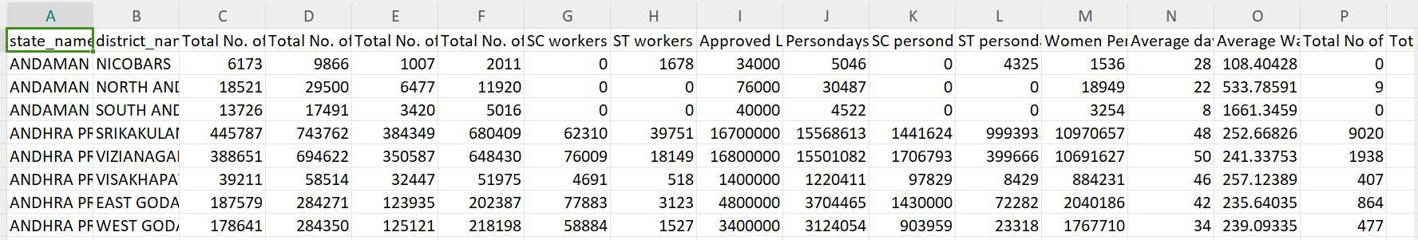
Tool Used
Power BI
The dataset for the analysis is obtained from official government records and contains data on the implementation of NREGA across various states and districts in India. This dataset includes 30 columns.

Slide 5
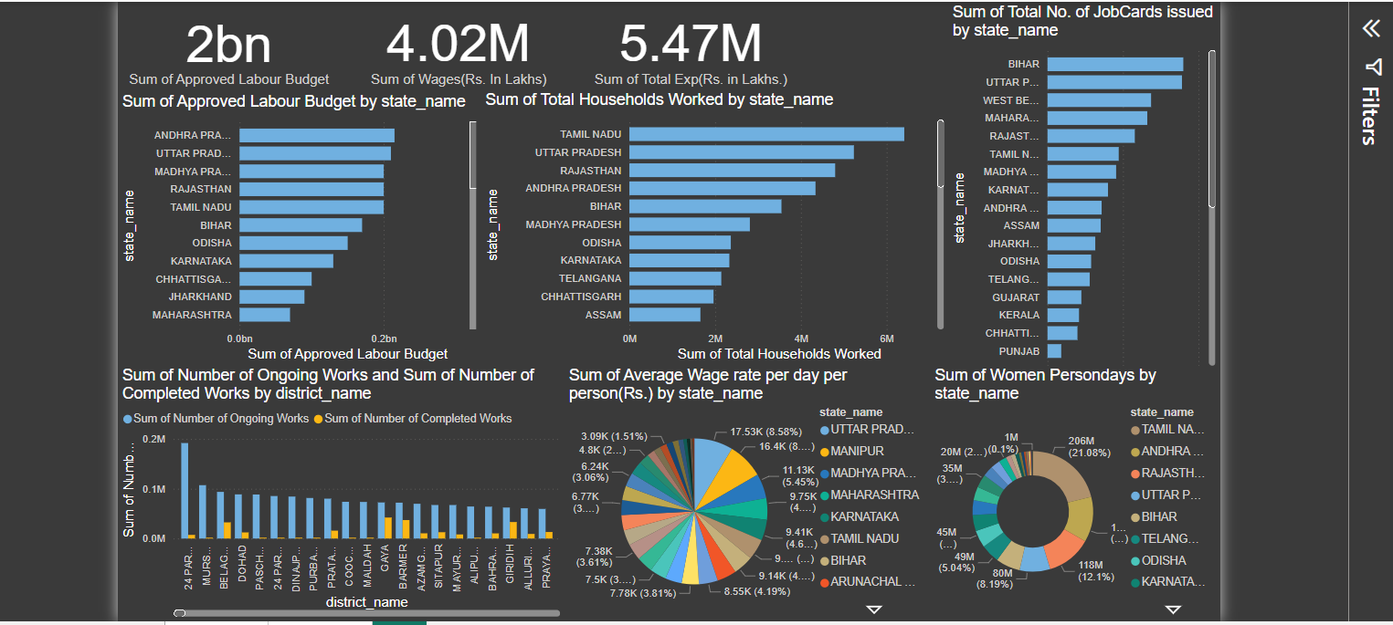
NGREGA ANALYSIS

Slide 6
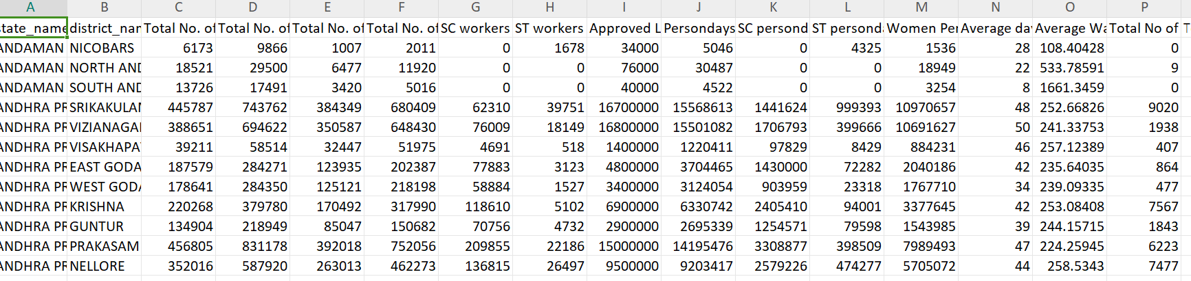
Details
The analysis delivers an extensive evaluation of NREGA's effectiveness, pinpointing its strong points, shortcomings, and areas for enhancement. This insight can support the development of better policies and the efficient distribution of resources to improve the program's influence on rural employment and poverty alleviation.

Slide 7
Findings
Employment Provision
States such as Andhra Pradesh demonstrate high engagement with hundreds of thousands of active workers in districts like Kurnool, Nandyal, and Nellore. This highlights NREGA's critical role in providing employment in these areas.
Regional Disparities
State-level Disparities: High approved labor budgets are noted in states like Andhra Pradesh, Uttar Pradesh, and Madhya Pradesh (ranging from 200M to 215M), correlating with higher numbers of active workers. In contrast, other states show lower engagement and budget allocations.
District-level Disparities: Specific districts such as 24 Parganas, Murshidabad, and Belagavi have a high number of ongoing works, pointing to regional concentration and potential disparities in project distribution.
Budget Allocation and Utilization
States with higher budgets tend to have better employment outcomes, as observed in Andhra Pradesh. However, some states with high budget allocations do not show proportional employment numbers, indicating possible inefficiencies or challenges in implementation.
Wage Rates and Their Impact

Slide 8
Average wage rates per day per person vary significantly, with higher rates in Andhra Pradesh. Higher wage rates are linked to greater worker participation, emphasizing the importance of wage rates in worker engagement.
Completion and Ongoing Projects
Ongoing Works: Many projects remain ongoing, with districts like 24 Parganas and Murshidabad showing a high number of such works, which points to potential delays and challenges in project completion.
Completion Rates: The number of completed works is relatively low, suggesting a need for better project management and timely completion strategies.
Women Engagement
High numbers of women person-days are recorded in districts like Tiruvannamalai, Dungarpur, and Villupuram, indicating successful inclusion efforts.

Slide 9
Thank You

